Slide 1
AVR Microcontroller
Microprocessor Course
Chapter 8
AVR HARDWARE CONNECTION,HEX FILE
AND FLASH LOADERS
Aban 1397 (Version 1.2)

Slide 2
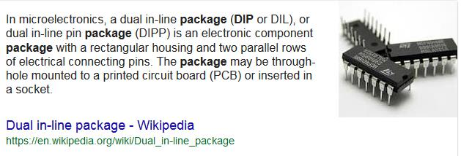
AVR I/O PORT PROGRAMMING 8.1 ATMEGA 32 PIN CONNECTION
The ATmega family members come in different packages, such as
DIP (dual in-line package),
MLF (Micro Lead Frame Package), and
QFP (quad flat package).
Notes:
The ATmega family members come in different packages, such as DIP (dual in-line package), MLF (Micro Lead Frame Package), and QFP (quad flat package). They all have many pins that are dedicated to various functions such as 110, ADC, timer, and interrupts. Notice that Atmel provides a 28-pin version of the ATmega family (ATmega8) with a reduced number of I10 ports for less demanding applications. In Chapter 1 you can see members of the ATmega family and their characteristics. Because the vast majority of educational trainers use the 40-pin chip, we will concentrate on that. Figure 8-1 shows the pins for the ATmega32.

Slide 3
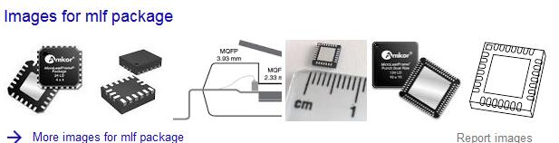
AVR I/O PORT PROGRAMMING 8.1 ATMEGA 32 PIN CONNECTION
The ATmega family members come in different packages, such as
DIP (dual in-line package),
MLF (Micro Lead Frame Package), and
QFP (quad flat package).
Notes:
The ATmega family members come in different packages, such as DIP (dual in-line package), MLF (Micro Lead Frame Package), and QFP (quad flat package). They all have many pins that are dedicated to various functions such as 110, ADC, timer, and interrupts. Notice that Atmel provides a 28-pin version of the ATmega family (ATmega8) with a reduced number of I10 ports for less demanding applications. In Chapter 1 you can see members of the ATmega family and their characteristics. Because the vast majority of educational trainers use the 40-pin chip, we will concentrate on that. Figure 8-1 shows the pins for the ATmega32.

Slide 4
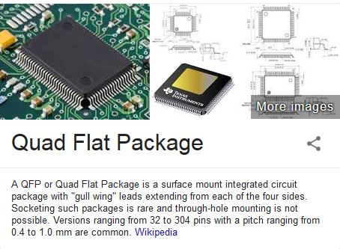
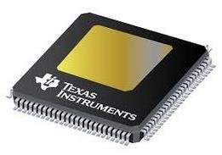
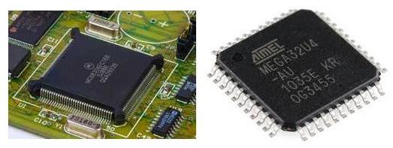
AVR I/O PORT PROGRAMMING 8.1 ATMEGA 32 PIN CONNECTION
The ATmega family members come in different packages, such as
DIP (dual in-line package),
MLF (Micro Lead Frame Package), and
QFP (quad flat package).
Notes:
The ATmega family members come in different packages, such as DIP (dual in-line package), MLF (Micro Lead Frame Package), and QFP (quad flat package). They all have many pins that are dedicated to various functions such as 110, ADC, timer, and interrupts. Notice that Atmel provides a 28-pin version of the ATmega family (ATmega8) with a reduced number of I10 ports for less demanding applications. In Chapter 1 you can see members of the ATmega family and their characteristics. Because the vast majority of educational trainers use the 40-pin chip, we will concentrate on that. Figure 8-1 shows the pins for the ATmega32.

Slide 5
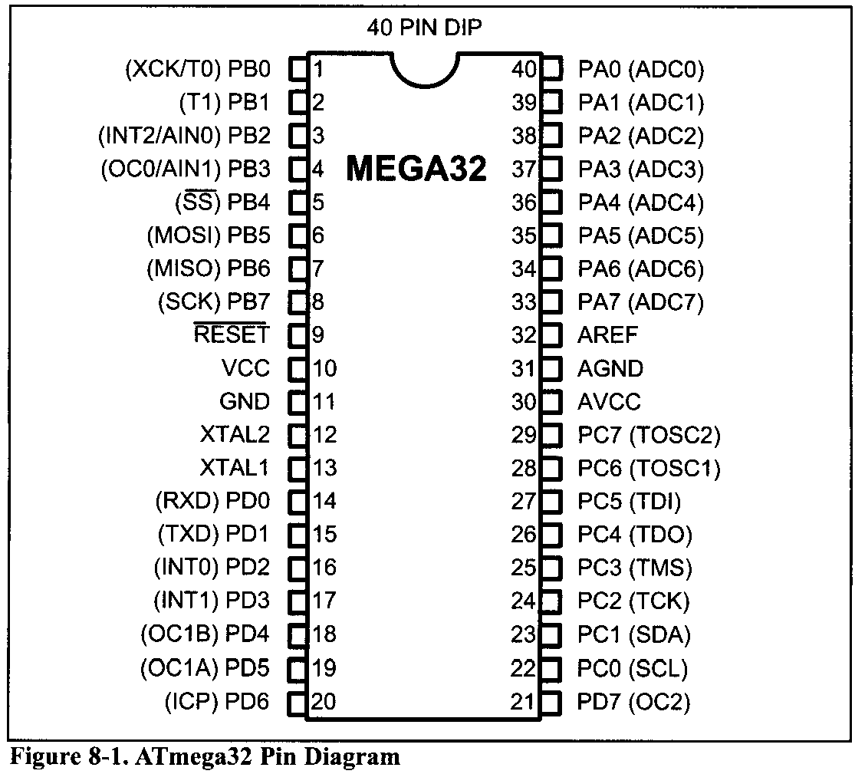
AVR I/O PORT PROGRAMMING 8.1 ATMEGA 32 PIN CONNECTION
Figure 8-1 shows the pins for the ATmega32. DIP (dual in-line package),
Notes:
The ATmega family members come in different packages, such as DIP (dual in-line package), MLF (Micro Lead Frame Package), and QFP (quad flat package). They all have many pins that are dedicated to various functions such as 110, ADC, timer, and interrupts. Notice that Atmel provides a 28-pin version of the ATmega family (ATmega8) with a reduced number of I10 ports for less demanding applications. In Chapter 1 you can see members of the ATmega family and their characteristics. Because the vast majority of educational trainers use the 40-pin chip, we will concentrate on that. Figure 8-1 shows the pins for the ATmega32.

Slide 6
AVR I/O PORT PROGRAMMING 8.1 ATMEGA 32 PIN CONNECTION
VCC
This pin provides supply voltage to the chip. The typical voltage source is +5 V. Some AVR family members have lower voltage for VCC pins in order to reduce the noise and power dissipation of the AVR system.
For example, ATmega32L operation voltage is 2.7-5.5 V. We can choose other options for the operating voltage level by setting BOD fuse bits.
AVCC
AVCC is the supply voltage pin for Port A and the A/D Converter. It should be externally connected to VCC, even if the ADC is not used. In Chapter 13 you will see how to connect this pin if you want to use ADC.
Notes:
The ATmega family members come in different packages, such as DIP (dual in-line package), MLF (Micro Lead Frame Package), and QFP (quad flat package). They all have many pins that are dedicated to various functions such as 110, ADC, timer, and interrupts. Notice that Atmel provides a 28-pin version of the ATmega family (ATmega8) with a reduced number of I10 ports for less demanding applications. In Chapter 1 you can see members of the ATmega family and their characteristics. Because the vast majority of educational trainers use the 40-pin chip, we will concentrate on that. Figure 8-1 shows the pins for the ATmega32.

Slide 7
AVR I/O PORT PROGRAMMING 8.1 ATMEGA 32 PIN CONNECTION
AREF
AREF is the analog reference pin for ADC. In Chapter 13 we will discuss it further.
GND
Two pins are also used for ground. In chips with 40 pins and more, it is common to have multiple pins for VCC and GND. This will help reduce the noise (ground bounce) in high-frequency systems.

Slide 8
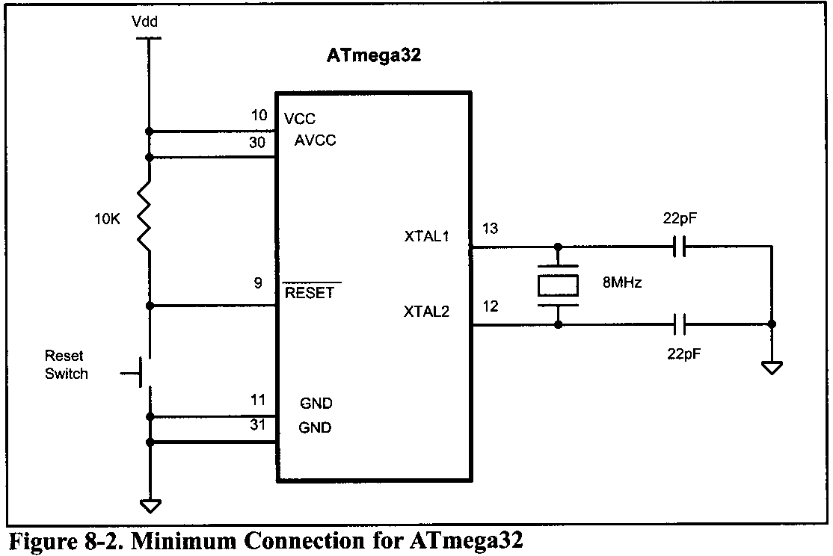
AVR I/O PORT PROGRAMMING 8.1 ATMEGA 32 PIN CONNECTION
XTALl and XTAL2
The ATmega32 has many options for the clock source. Most often a quartz crystal oscillator is connected to input pins XTALl and XTAL2. The quartz crystal oscillator connected to the XTALl and XTAL2 pins also needs two capacitors.
ATmega32 microcontrollers can have speeds of 0 Hz to 16 MHz.

Slide 9
AVR I/O PORT PROGRAMMING 8.1 ATMEGA 32 PIN CONNECTION
RESET
Pin 9 (in the ATmega32, 40-pin DIP) is the RESET pin. It is an input and is active-LOW (normally HIGH). When a LOW pulse is applied to this pin, the microcontroller will reset and terminate all activities.
After applying reset, contents of all registers and SRAM locations will be cleared. Notice that after applying reset, all ports will be input because contents of all DDR registers are cleared.
The CPU will start executing the program from run location 0x00000 after a brief delay when the RESET pin is forced low and then released.

Slide 10
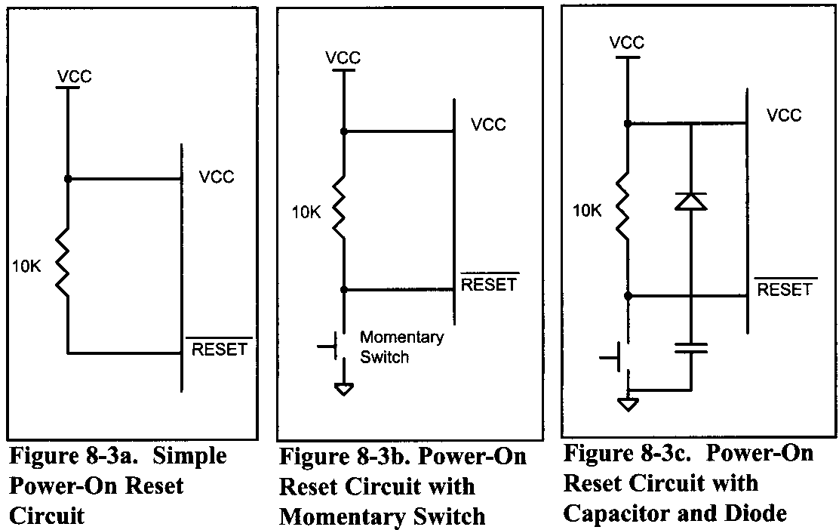
AVR I/O PORT PROGRAMMING 8.1 ATMEGA 32 PIN CONNECTION
Figures 8-3a, 8-3b, and 8-3c show three ways of connecting the RESET pin. Figure 8-3b uses a momentary switch for reset circuitry. Some designers put a 10nF capacitor between the RESET pin and GND to filter the noise during reset and working time. See Figure 3-8c. The diode protects the RESET pin from being powered by the capacitor when the power is off.

Slide 11
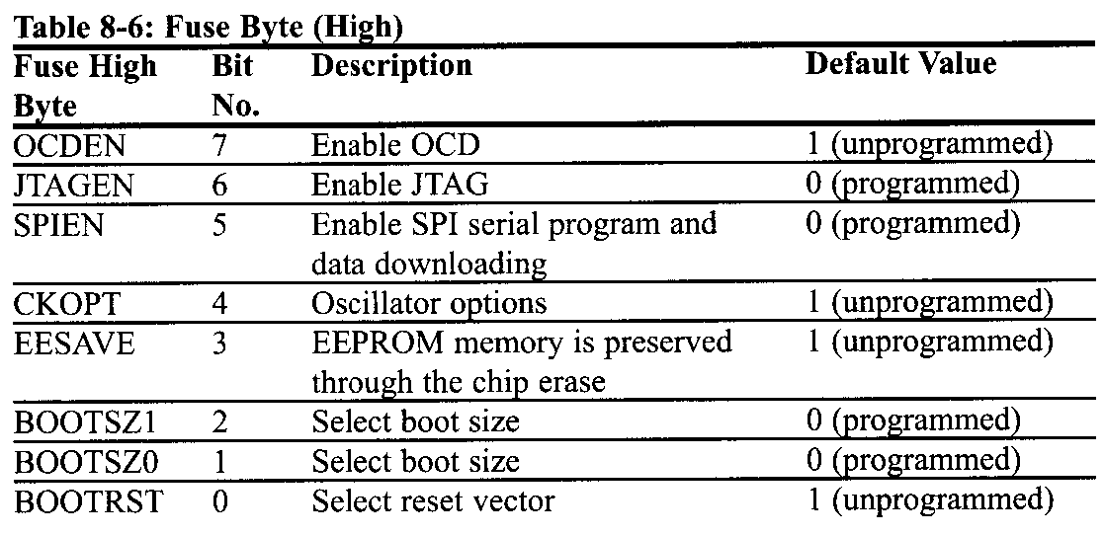
AVR I/O PORT PROGRAMMING SECTION 8.2: AVR FUSE BITS
There are some features of the AVR that we can choose by programming the bits of fuse bytes. These features will reduce system cost by eliminating any need for external components.
ATmega32 has two fuse bytes. Tables 8-6 and 8-7 give a short description of the fuse bytes.

Slide 12
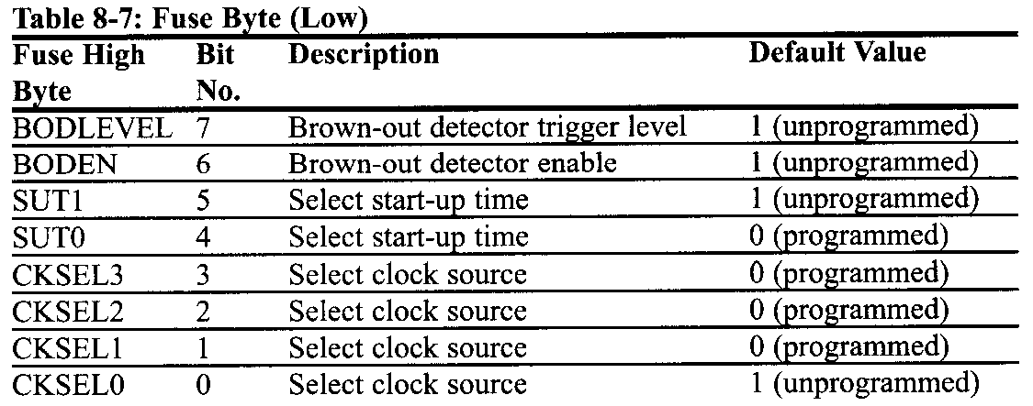
AVR I/O PORT PROGRAMMING SECTION 8.2: AVR FUSE BITS

Slide 13
AVR I/O PORT PROGRAMMING SECTION 8.2: AVR FUSE BITS
Notice that the default values can be different from production to production and time to time.
It must be noted that if a fuse bit is incorrectly programmed, it can cause the system to fail.
An example of this is changing the SPIEN bit to 0, which disables SPI programming mode. In this case you will not be able to program the chip any more!
Also notice that the fuse bits are '0' if they are programmed and ' 1' when they are not programmed.

Slide 14
AVR I/O PORT PROGRAMMING SECTION 8.2: AVR FUSE BITS
LOCK BITS
In addition to the fuse bytes in the AVR, there are 4 lock bits to restrict access to the Flash memory. These allow you to protect your code from being copied by others.
In the development process it is not recommended to program lock bits because you may decide to read or verify the contents of Flash memory.

Slide 15
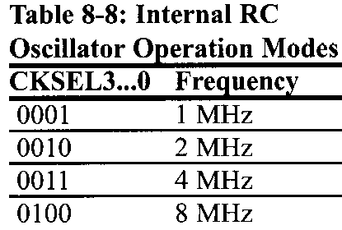
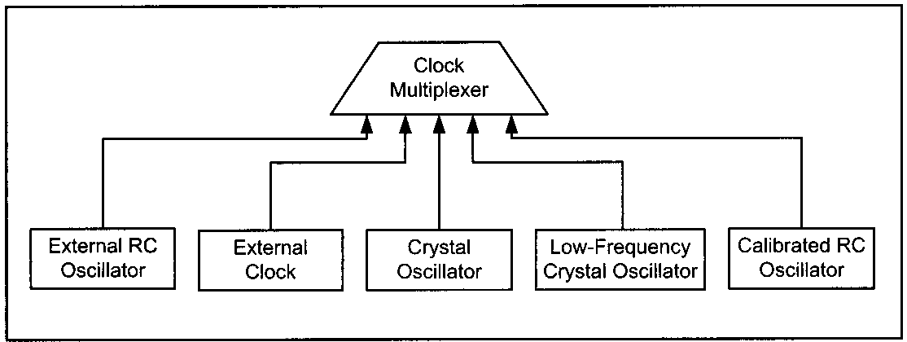
AVR I/O PORT PROGRAMMING SECTION 8.2: AVR FUSE BITS
Fuse bits and oscillator clock source
You can choose one by setting or clearing any of the bits CKSEL0 to CKSEL3. The default choice is internal RC (0001), which uses the on-chip RC oscillator.
Notes:
In this option there is no need to connect an external crystal and capacitors to the chip. As you see in Table 8-8, by changing the values of CKSEL0..CKSEL3 we can choose among 1,2,4, or 8 MHz internal RC frequencies; but it must be noted that using an internal RC oscillator can cause about 3% inaccuracy and is not recommended in applications that need precise timing.

Slide 16
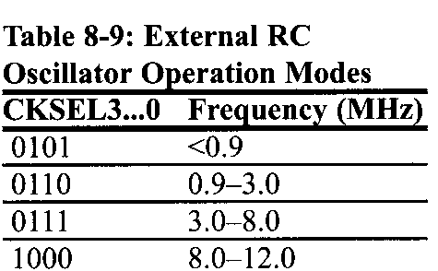
AVR I/O PORT PROGRAMMING SECTION 8.2: AVR FUSE BITS
The external RC oscillator is another source to the CPU. As you see in Figure 8-5, to use the external RC oscillator, you have to connect an external resistor and capacitors to the XTAL1 pin.
The frequency of the RC oscillator circuit is estimated by the equation f = 1/(3RC). Notice that the capacitor value should be at least 22 pF. Also, notice that by programming the CKOPT fuse, you can enable an internal 36 pF capacitor between XTAL1 and GND, and remove the external capacitor. As you see in Table 8-9, by changing the values of CKSEL0-CKSEL3, we can choose different frequency ranges.

Slide 17
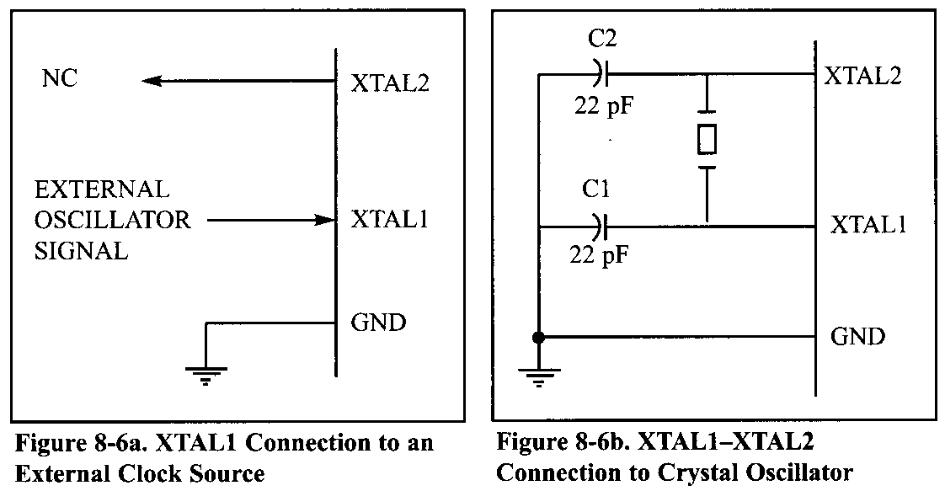
AVR I/O PORT PROGRAMMING SECTION 8.2: AVR FUSE BITS
By setting CKSEL0…3 bits to 0000, we can use an external clock source for the CPU.
The most widely used option is to connect the XTAL1 and XTAL2 pins to a crystal (or ceramic) oscillator
Notes:
In this mode, when CKOPT is programmed, the oscillator output will oscillate with a full rail-to-rail swing on the output, causing a more powerful clock signal. This is suitable when the chip drives a second clock buffer or operates in a very noisy environment. As you see in Table 8-10, this mode has a wide frequency range.

Slide 18
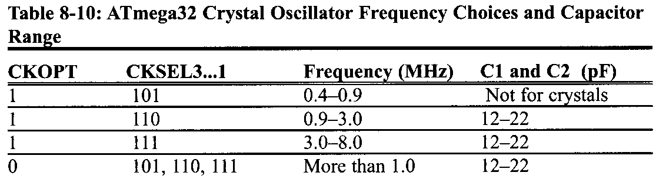
AVR I/O PORT PROGRAMMING SECTION 8.2: AVR FUSE BITS
When CKOPT is not programmed, the oscillator has a smaller output swing and a limited frequency range. This mode cannot be used to drive other clock buffers, but it does reduce power consumption considerably. There are four choices for the crystal oscillator option.
Table 8-10 shows all of these choices. Notice that mode 101 cannot be used with crystals, and only ceramic resonators can be used.

Slide 19
AVR I/O PORT PROGRAMMING SECTION 8.2: AVR FUSE BITS
Example 8-1 shows the relation between crystal frequency and instruction cycle time.
Example 8-1
Find the instruction cycle time for the ATmega32 chip with the following crystal oscillators connected to the XTAL1 and XTAL2 pins.
(a) 4 MHz (b) 8 MHz (c) 10 MHz
Solution:
Instruction cycle time is 1/(4 MHz) = 250 ns
Instruction cycle time is 1/(8 MHz) = 125 ns
Instruction cycle time is 1/(10 MHz) = 100 ns

Slide 20
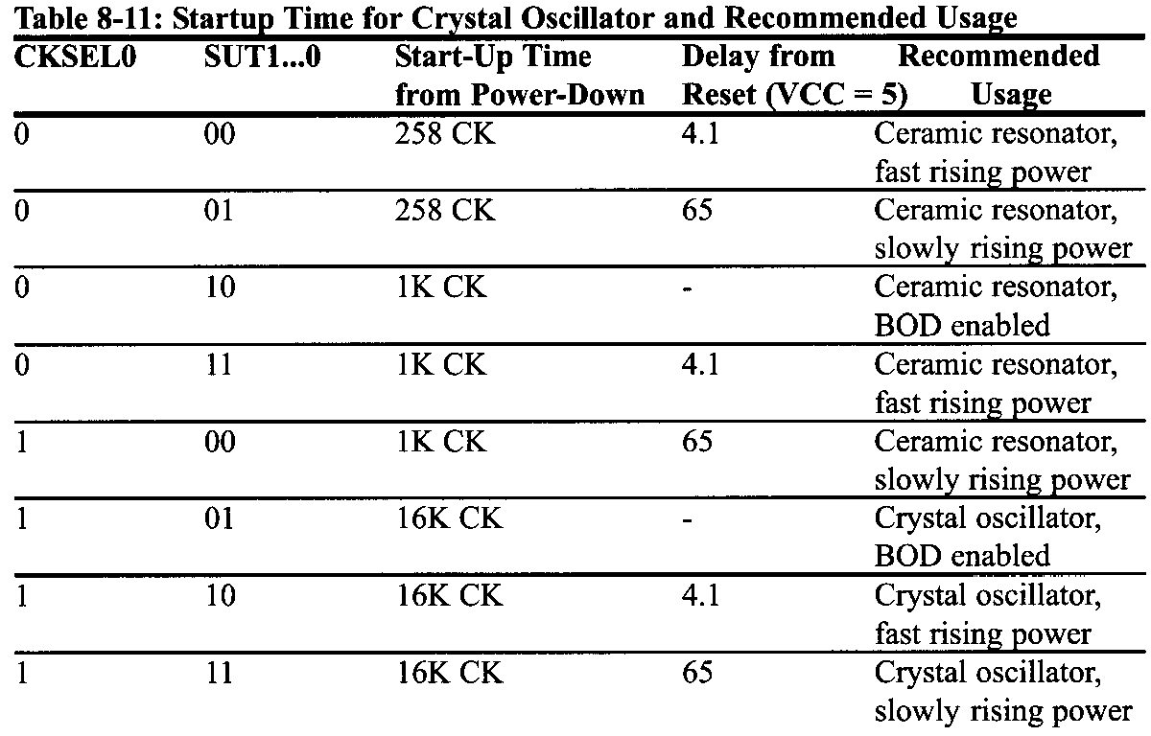
AVR I/O PORT PROGRAMMING SECTION 8.2: AVR FUSE BITS
Fuse bits and reset delay & SUT1,SUT0 and CKSEL0
The most difficult time for a system is during power-up. The CPU needs both a stable clock source and a stable voltage level to function properly. In AVRs, after all reset sources have gone inactive, a delay counter is activated to make the reset longer.

Slide 21
AVR I/O PORT PROGRAMMING SECTION 8.2: AVR FUSE BITS
Brown-out detector
Occasionally, the power source provided to the Vcc pin fluctuates, causing the CPU to malfunction. The ATmega family has a provision for this, called brown-out detection.
The BOD circuit compares VCC with BOD-Level and resets the chip if VCC falls below the BOD-Level. The BOD-Level can be either 2.7 V when the BODLEVEL fuse bit is one (not programmed) or 4.0 V when the BODLEVEL fuse is zero (programmed).
You can enable the BOD circuit by programming the BODEN fuse bit. When VCC increases above the trigger level, the BOD circuit releases the reset, and the MCU starts working after the time-out period has expired.

Slide 22
AVR I/O PORT PROGRAMMING 8.3: EXPLAINING THE HEX FILE FOR AVR
Intel Hex is a widely used file format designed to standardize the loading (transferring) of executable machine code into a chip. Therefore, the loaders that come with every ROM burner (programmer) support the Intel Hex file format. In many Windows-based assemblers such as AVR Studio, the Intel Hex file is produced according to the settings you set.
In the AVR Studio environment, the object file is fed into the linker program to produce the Intel hex file. The hex file is used by a programmer such as the AVRISP to transfer (load) the file into the Flash memory.
The AVR Studio assembler can produce three types of hex files. They are
Intel Intellec 8MDS (Intel Hex),
Motorola S-record, and
Generic.

Slide 23
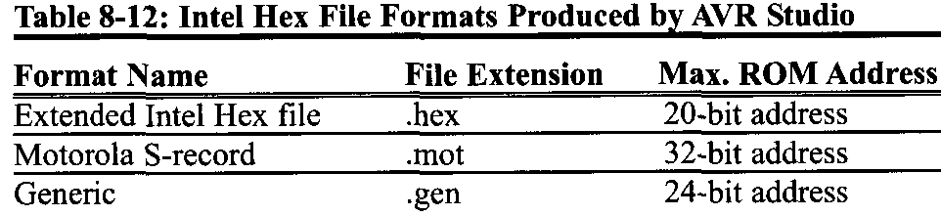
AVR I/O PORT PROGRAMMING 8.3: EXPLAINING THE HEX FILE FOR AVR
See Table 8-12. In this section we will explain Intel Hex with some examples.

Slide 24
AVR I/O PORT PROGRAMMING 8.3: EXPLAINING THE HEX FILE FOR AVR
Analyzing the Intel Hex file
We choose the hex type of Intel Hex, Motorola S-record, or Generic by using the command-line invocation options or setting the options in the AVR Studio assembler itself. If we do not choose one, the AVR Studio assembler selects Intel Hex by default.
Intel Hex supports up to 16-bit addressing and is not applicable for programs more than 64K bytes in size. To overcome this limitation AVR Studio uses extended Intel Hex files, which support type 02 records to extend address space to 1M. Figure 8-10 shows the Intel Hex file of the test program whose list file is given in Figure 8-8.

Slide 25
AVR I/O PORT PROGRAMMING 8.3: EXPLAINING THE HEX FILE FOR AVR
Since the programmer (loader) uses the Hex file to download the opcode into Flash, the hex file must provide the following:
the number of bytes of information to be loaded,
the information itself, and
the starting address where the information must be placed.
Each record (line) of the Hex file consists of six parts as follows:
:BBAAAATTHHHHH…….HHHHHCC

Slide 26
AVR I/O PORT PROGRAMMING 8.3: EXPLAINING THE HEX FILE FOR AVR
The following describes each part:
1. ":" Each line starts with a colon.
2. BB, the count byte. This tells the loader how many bytes are in the line.
3. AAAA is for the record address. This is a 16-bit address. The loader places the first byte of record data into this Flash location. This is the case in files that are less than 64 KB. For files that are more than 64 KB the address field shows the record address in the current segment.
4. TT is for type. This field is 00,01, or 02. If it is 00, it means that there are more lines to come after this line. If it is 01, it means that this is the last line and the loading should stop after this line. If it is 02, it indicates the current segment address. To calculate the absolute address of each record (line), we have to shift the current segment address 4 bits to left and then add it to the record address

Slide 27
AVR I/O PORT PROGRAMMING 8.3: EXPLAINING THE HEX FILE FOR AVR
5. HH ...... H is the real information (data or code). The loader places this information into successive memory locations of Flash. The information in this field is presented as low byte followed by the high byte.
6. CC is a single byte. This last byte is the checksum byte for everything in that line. The checksum byte is used for error checking. Notice that the checksum byte at the end of each line represents the checksum byte for everything in that line, and not just for the data portion.

Slide 28
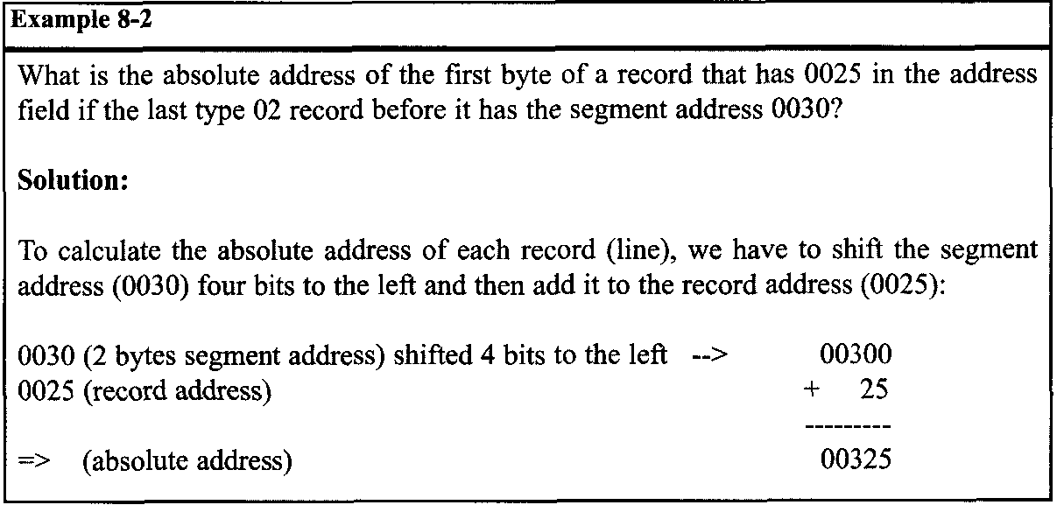
AVR I/O PORT PROGRAMMING 8.3: EXPLAINING THE HEX FILE FOR AVR

Slide 29
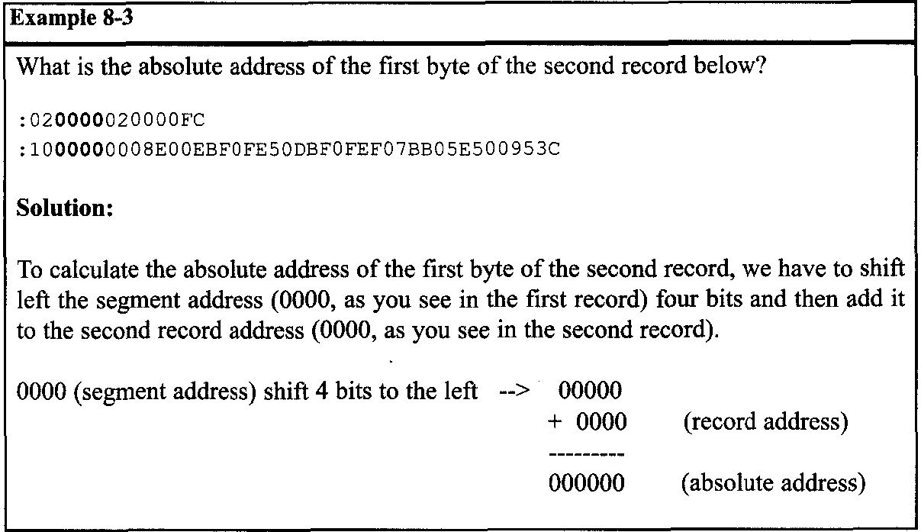
AVR I/O PORT PROGRAMMING 8.3: EXPLAINING THE HEX FILE FOR AVR

Slide 30
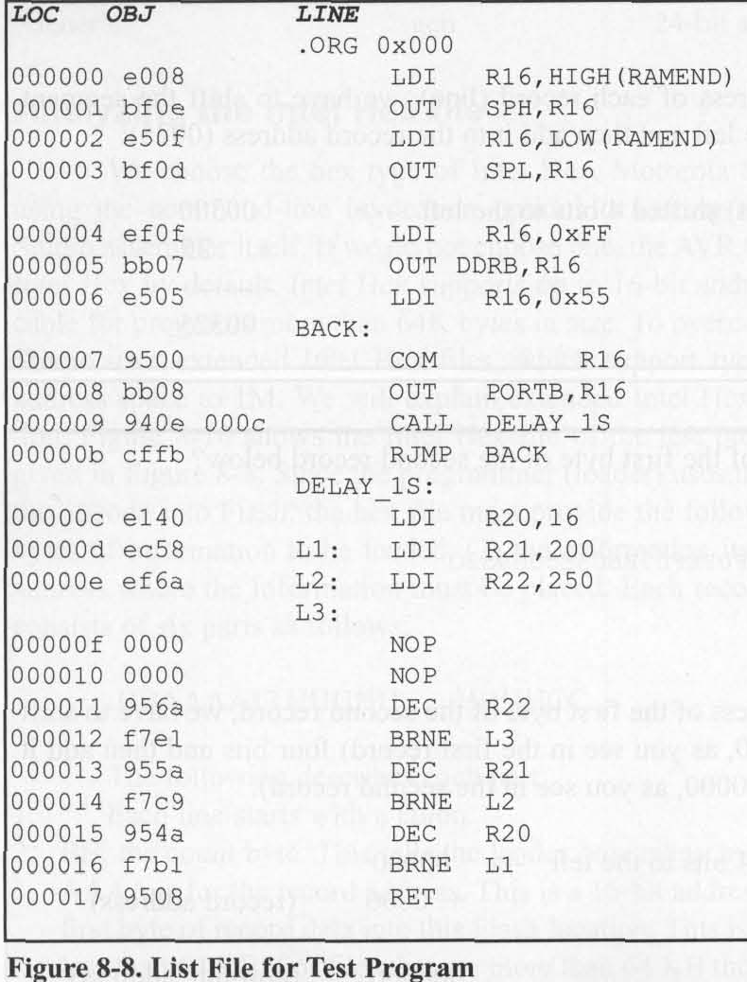
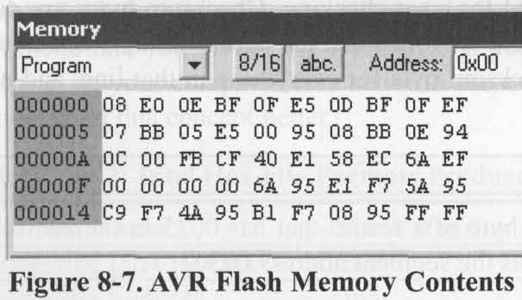
AVR I/O PORT PROGRAMMING 8.3: EXPLAINING THE HEX FILE FOR AVR
Analyzing the bytes in the Flash memory vs. list file
Notes:
The data in the Flash memory of the AVR is recorded in a way that is called Little-endian. This means that the high byte of the code is located in the higher address location of Flash memory, and the low byte of the code is located in the lower address location of Flash memory.

Slide 31
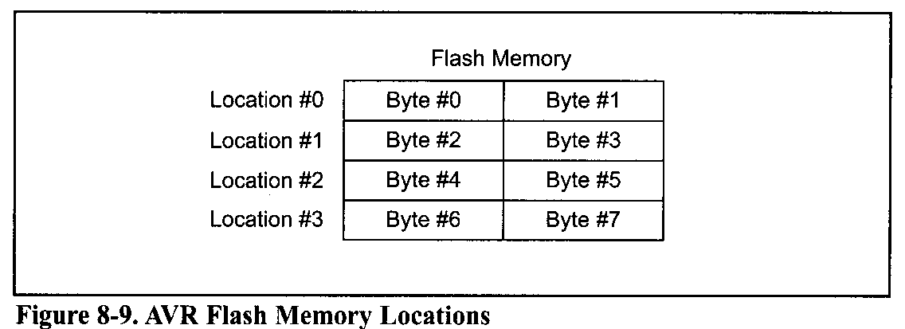
AVR I/O PORT PROGRAMMING 8.3: EXPLAINING THE HEX FILE FOR AVR
As we mentioned, each Flash location in the AVR is 2 bytes long. So, for example, the first byte of Flash location #2 is Byte #4 of the code.

Slide 32
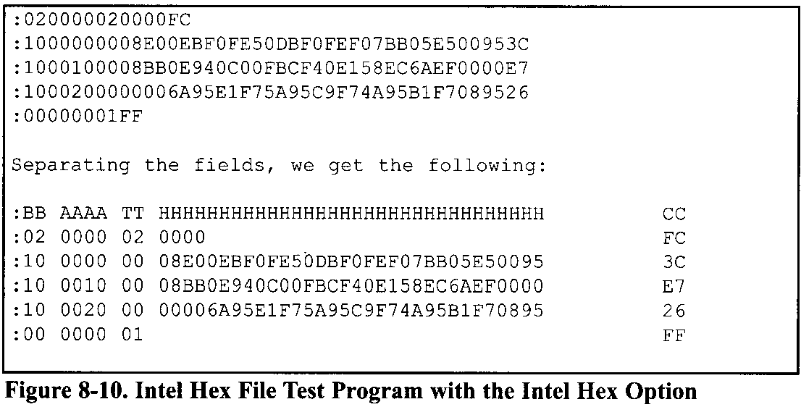
AVR I/O PORT PROGRAMMING 8.3: EXPLAINING THE HEX FILE FOR AVR
The first record (line) is a type 02 record and indicates the current segment address, which is 0000.
In Figure 8-10 you see the hex file of the toggle code.
The next field is the data field, which contains the code to be loaded into the chip.
checksum byte
The next record (line) is a type 00 record and contains the data (the code to be loaded into the chip). After ':' the record starts with 10, which means that the data field contains 10 (16 decimal) bytes of data.
The next field is the address field (0000), and it indicates that the first byte of the data field will be placed in address location 0 in the current segment.
Notes:
So the first byte of code will be loaded into location 0 of Flash memory. (Reexamine Example 8-3 if needed.) Also, notice the use of .ORG 0x0000 in the code. The next field is the data field, which contains the code to be loaded into the chip. The first byte of the data field is 08, which is the low byte of the first instruction (LDI R16, HIGH (RAMEND)) .See Figure 8-8. The last field of the record is the checksum byte of the record. Notice that the checksum byte at the end of each line represents the checksum byte for everything in that line, and not just for the data portion.

Slide 33
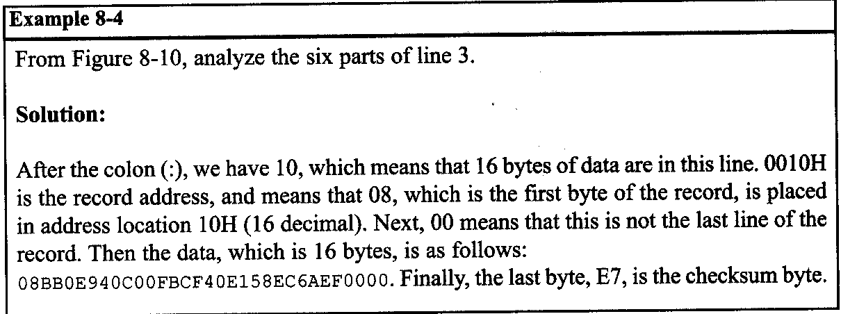
AVR I/O PORT PROGRAMMING 8.3: EXPLAINING THE HEX FILE FOR AVR

Slide 34
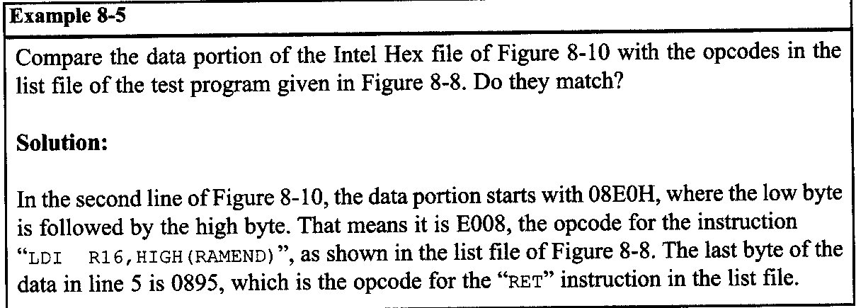
AVR I/O PORT PROGRAMMING 8.3: EXPLAINING THE HEX FILE FOR AVR

Slide 35
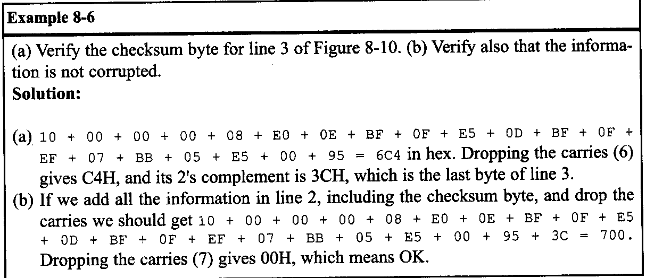
AVR I/O PORT PROGRAMMING 8.3: EXPLAINING THE HEX FILE FOR AVR

Slide 36
AVR I/O PORT PROGRAMMING 8.4: AVR PROGRAMMING AND TRAINER BOARD
We show various ways of loading a hex file into the AVR. Atmel has skillfully designed AVR microcontrollers for maximum flexibility of loading programs there three primary ways to load a program:
parallel programming. In this way a device burner loads the program into the microcontroller separate from the system. This is useful on a manufacturing floor where a gang programmer is used to program many chips at one time. The chip is programmed before it is inserted into the circuit.
Serial in-circuit programming this kind of programmer allows the developer to program and debug their microcontroller while it is in the system. AVR has two methods of ISP. They are SPI and JTAG. Most of the Atmega family supports both methods. The SPI uses 3 pins. Notice that SPI stands for “Serial Peripheral Interface” and is a protocol. But ISP stands for “In-circuit Serial Programming” and is a method of code loading. AVRISP and many other devices support ISP. To connect AVRISP to your device you also need to connect VCC, GND and RESET pins.

Slide 37
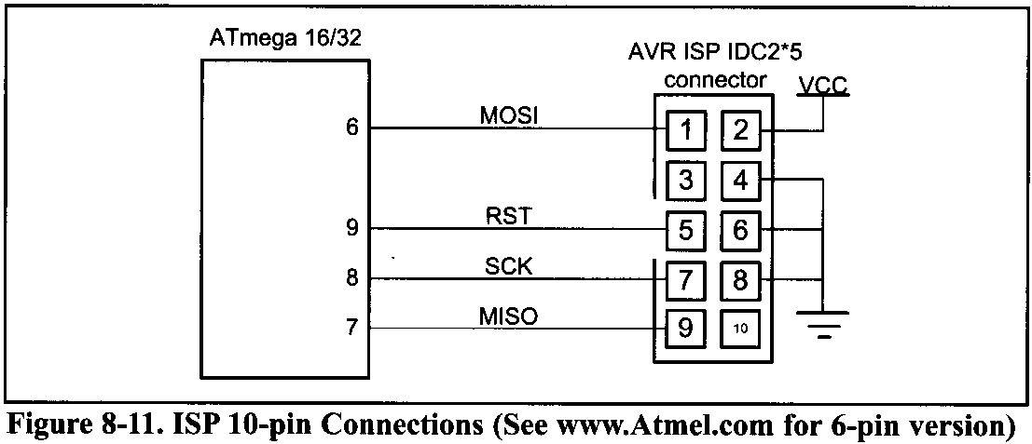
AVR I/O PORT PROGRAMMING 8.4: AVR PROGRAMMING AND TRAINER BOARD
Another method of ISP is JTAG. JTAG is another protocol that supports in-circuit programming and debugging. It means that in addition to programming you can trace your program on the chip line by line and watch or change the values of memory locations, ports, or registers while your program is running on the chip.

Slide 38
AVR I/O PORT PROGRAMMING 8.4: AVR PROGRAMMING AND TRAINER BOARD
A boot loader is a piece of code burned into the microcontroller's program Flash.
Its purpose is to communicate with the user's board to load the program. A boot loader can be written to communicate via a serial port, a CAN port, a USB port, or even a network connection.
A boot loader can also be designed to debug a system, similar to the JTAG. This method of programming is excellent for the developer who does not always have a device programmer or a JTAG available. There are several application notes on writing boot loaders on the Web. The main drawback of the boot loader is that it does require a communication port and program code space on the microcontroller.
Also, the boot loader has to be programmed into the device before it can be used, usually by one of the two previous ways.
Notes:
The boot loader method is ideal for the developer who needs to quickly program and test code. This method also allows the update of devices in the field without the need of a programmer. All one needs is a computer with a port that is compatible with the board. (The serial port is one of the most commonly used and discussed, but a CAN or USB boot loader can also be written.) This method also consumes the largest amount of resources. Code space must be reserved and protected, and external devices are needed to connect and communicate with the PC. Developing projects using this method really helps programmers test their code. For mature designs that do not change, the other two methods are better suited.

Slide 39
AVR I/O PORT PROGRAMMING 8.4: AVR PROGRAMMING AND TRAINER BOARD
AVR trainers
There are many popular trainers for the AVR chip. The vast majority of them have a built-in ISP programmer. See the following website for more information and support about the AVR trainers. For more information about how to use an AVR trainer you can visit the
www.MicroDigitalEd.com
website.

